Slide 1
Noughts and crosses
Green
1
2
3
Blue
O
4
5
6
x
7
8
9
Ten
It’s untidy.
Why is the room called the Tiger room? ?
What is the name of the room where Nick is staying?
How many rooms are there in the hotel?
It’s under the window.
In Da Lat
Is Nick’s room tidy or untidy?
Yes
Where is the bed in Nick’s room?
No
Where is that Crazy House Hotel?
Is there a wardrobe in Nick’s room?
Are the rooms named after different flowers?
Because there is a big tiger..
Tiger
With his parents
Who is Nick staying with?

Slide 2

Unit 2- My house
Period 14: Lesson 6: Skills 2

Slide 3

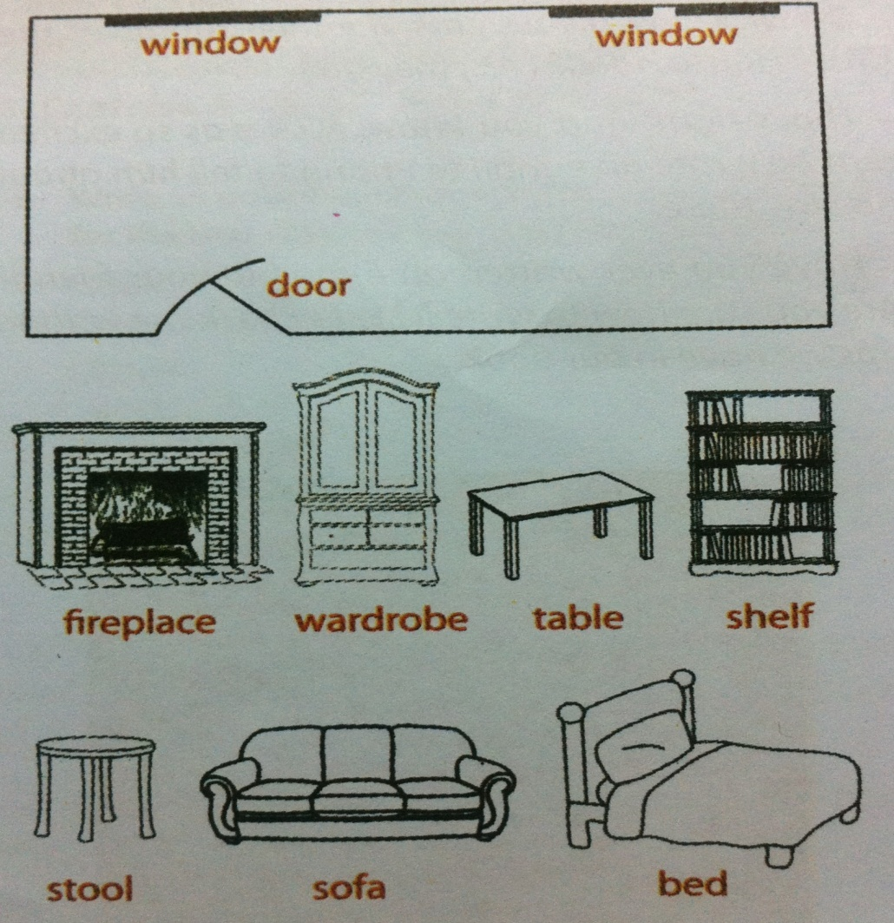
1. Listening
- (a) fireplace:
Bếp sưởi
- (a) stool :
Ghế đẩu

Slide 4



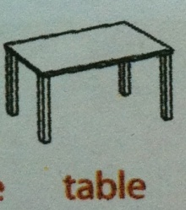




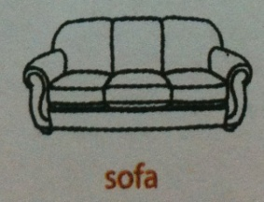
Exercise 1: Nick’s parents are describing their room at the hotel. Listen and draw the furniture in the correct place.
window
window
door

Slide 5
2.Writing
An e-mail to a friend
How to write an e-mail to a friend
1. In the subject of line, write briefly what an e-mail is about.
2. Beginning the e-mail with a greeting (Dear / Hi / Hello…)
3. The introduction is the first paragraph. We can ask about his/ her health, thank him/ her for the previous e-mail or write the reasons for e-mail, etc…
4. In the body, write the subject(s) of the e-mail. Write each subject in a new paragraph.
5. The conclusion is the last paragraph. It includes the closing remarks: saying goodbye, asking your friend to write back, sending your regards to his/her family, etc.

Slide 6

An e-mail to a friend
1. Subject ( chủ đề của email)
2. Greeting (Lời chào đầu thư)
Dear…., / Hi…., / Hello …..,
3. Introduction ( Phần đầu thư)
Ask about his/ her health, thank him/ her for…
4. Body ( Nội dung email)
5. Conclusion ( Kết thư)
Saying goodbye/ Asking your friend to write back/ Sending your regards to his/her family…

Slide 7
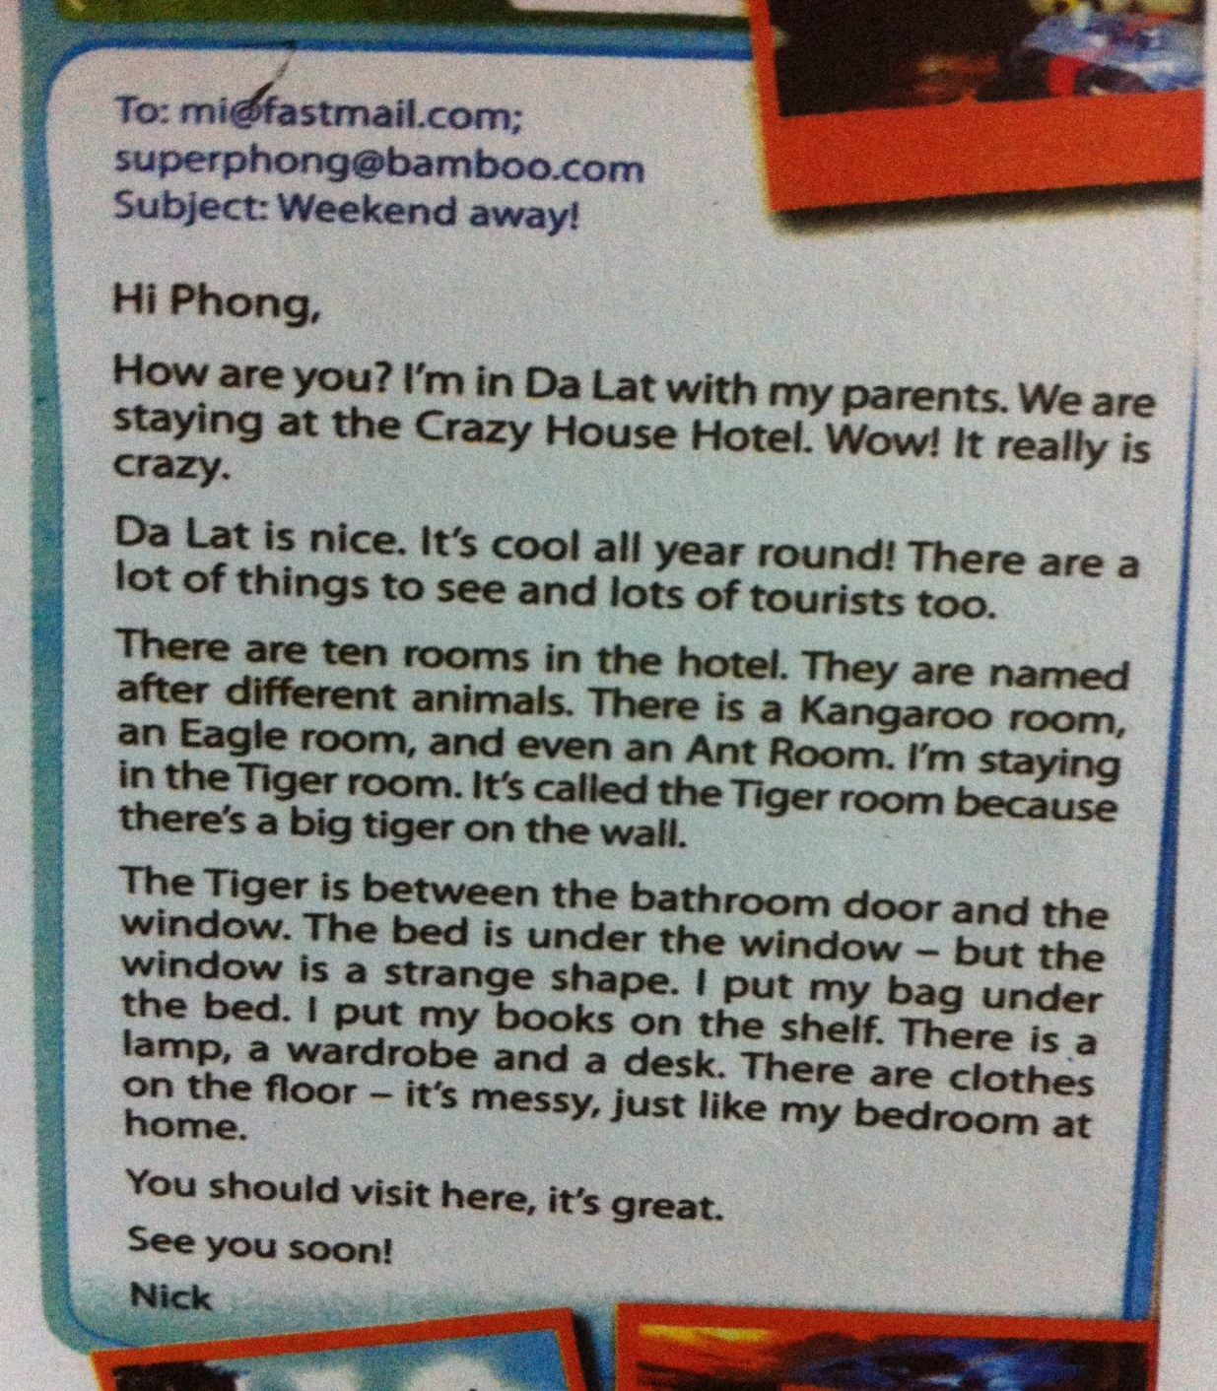
Exercise 2: Read Nick’s -email again. Identify the subject, greeting, introduction, body and conclusion of the e-mail.
Subject
Greeting
Introduction
Body
Conclusion

Slide 8
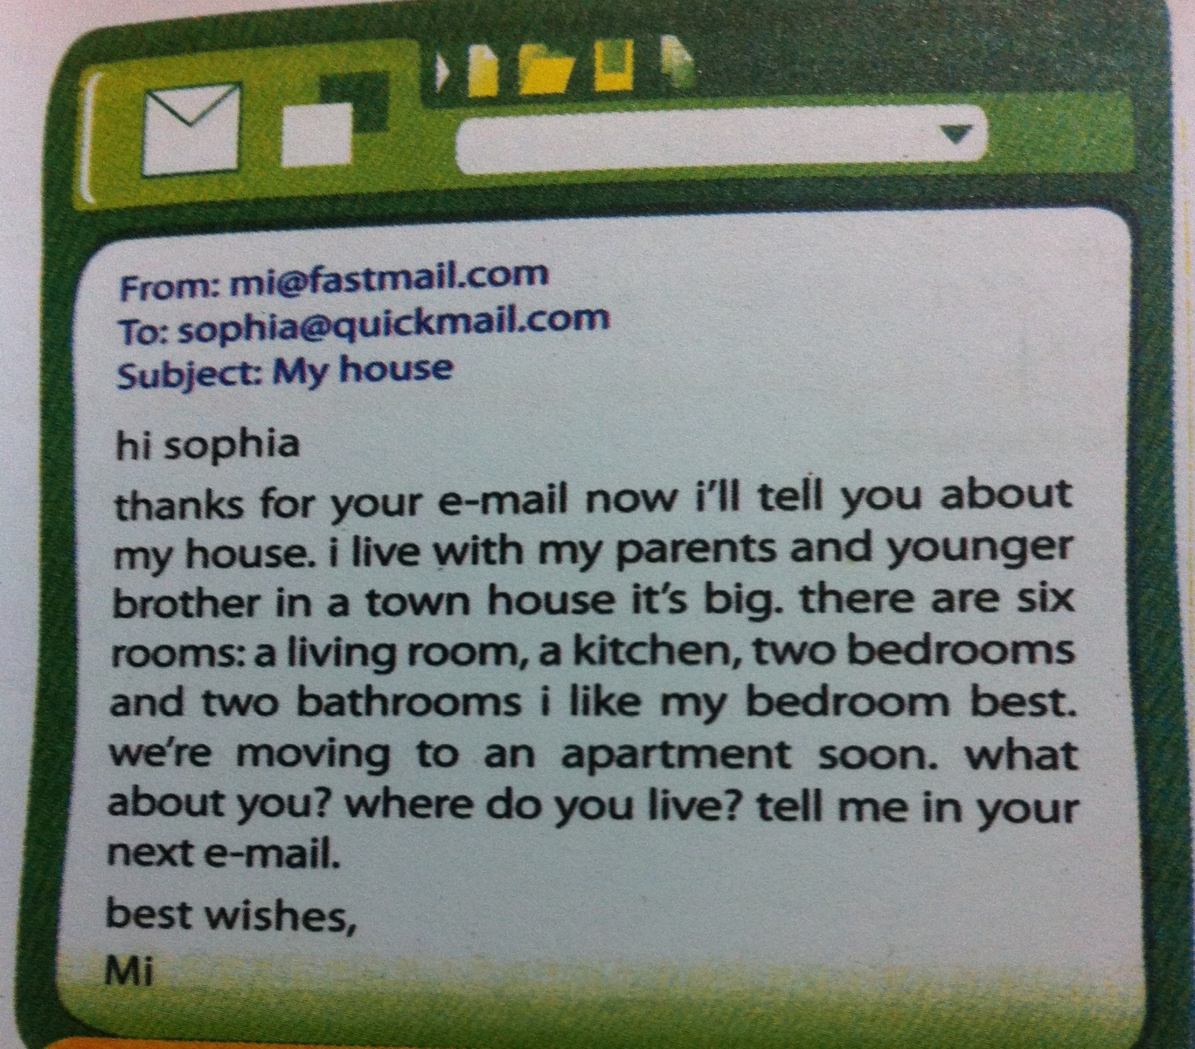
Exercise 3: Read the e-mail below and correct it. Write the correct version.

Slide 9
From: mi@fastmail.com
To: sophia@quickmail.com
Subject: My house
Hi Sophia,
Thanks for your e-mail. Now I’ll tell you about my house.
I live with my parents and my younger brother in a town house. It’s big. There are six rooms: a living room, a kitchen, two bedrooms and two bathrooms. I like my bedroom best. We’re moving to an apartment soon.
What about you? Where do you live? Tell me in the next e-mail.
Best wishes,
Mi

Slide 10

Exercise 4: Write an e-mail to nick. Tell him about your idea for the new room of the Crazy House Hotel.
1. Plan ( Lên dàn ý/ dàn bài)
Brainstorm vocabulary about your room
2. Draft ( Phác thảo)
Write a draft
3. Check
Check your draft: Is the punctuation correct? Is the capitalisation correct? Does it have all necessary part?

Slide 11

Homework
Finish your e-mail in your notebook.
Do exercise 1,2/ P.15- Workbook
Finish your Project.

